Slide 1



Verbal Explanations of Spatio-Temporal Graph Neural Networks for Traffic Forecasting
Master’s Thesis in eXplainable AI
Candidate: Riccardo Spolaor
Supervisor: Roberta Calegari
Co-supervisor: Panchamy Krishnakumari

Slide 2


Table of contents
01
02
03
04
Introduction
Methodology
Results
Conclusion

Slide 3

01
Introduction

Slide 4
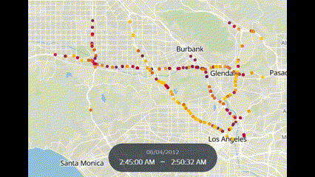
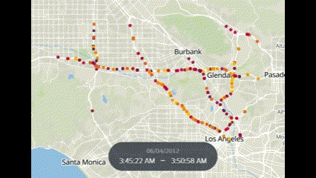


Objective
Explain traffic speed predictions in a traffic network given by a Spatio-Temporal Graph Neural Network (STGNN) to non-technical users
Traffic Network
STGNN¹
Input network
STGNN
Predicted network
. . .
[1] Wang et al., “Traffic Flow Prediction via Spatial Temporal Graph Neural Network”, Association for Computing Machinery 2020, https://doi.org/10.1145/3366423.3380186
t₀
t₁
t_{n}
Notes:
Traffic Network: A graph structure defining the speed of the nodes of a geographical network during a certain time window.
STGNN: Black-box model that given an input traffic network can predict the behavior of the traffic network in the future.

Slide 5
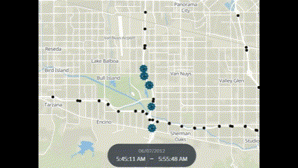
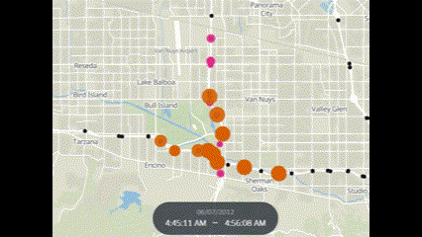
How?
Predicted network
Predicted event
Explain predicted event
Extracting important subgraph
In verbal form
Transparent computation
Model agnostic
Explains
Input network
Important subgraph
Notes:
Predicted Event: Subgraph of the predicted network representing a traffic congestion or free flow.
Concise subgraph of the input traffic network that can approximately correctly forecast the predicted event through the inference of the STGNN.

Slide 6
Motivation
Why STGNNs?
Black-box
Scarce academic literature^{1,2,3}
Why Verbal Explanations?
Social process of understanding⁴
[1] He et al., “An explainer for temporal graph neural networks”, 2022. https://arxiv.org/abs/2209.00807
[2] Xia et al., “Explaining Temporal Graph Models through an Explorer-Navigator Framework”, 2023, https://openreview.net/forum?id=BR_ZhvcYbGJ
[3] Tang et al. “Explainable spatio-temporal graph neural networks”, 2023, https://doi.org/10.1145/3583780.3614871
[4] Fouladgar et al., “XAI-P-T: A Brief Review of Explainable Artificial Intelligence from Practice to Theory”, 2020, https://arxiv.org/abs/2012.09636

Slide 7
02
Methodology

Slide 8
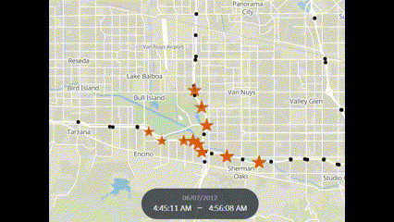
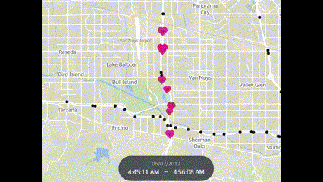
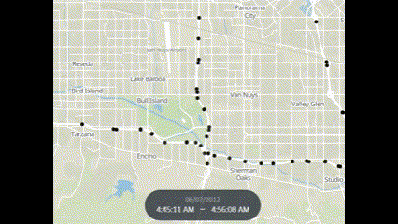
Framework
Explanation Phase
Cluster into
Input network
Global Search
Local Search
Important subgraph
Predicted event
Important subgraph events
Explains
Verbal Explanation Phase
Predicted event
Content Extraction
Verbal Translation
Extracted Content
Important subgraph events

Slide 9
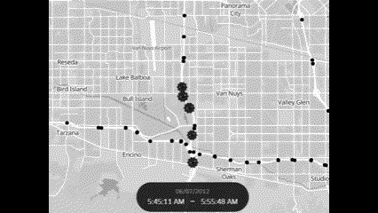
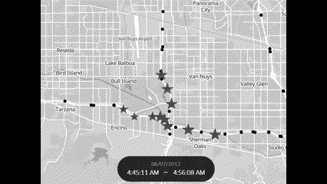
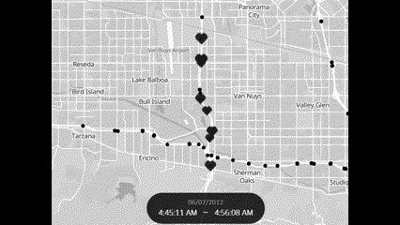
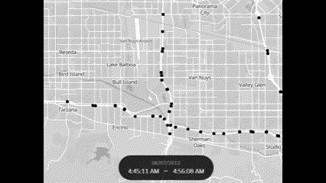
Framework
Explanation Phase
Cluster into
Input network
Global Search
Local Search
Important subgraph
Predicted event
Important subgraph events
Explains
Verbal Explanation Phase
Predicted event
Content Extraction
Verbal Translation
Extracted Content
Important subgraph events

Slide 10
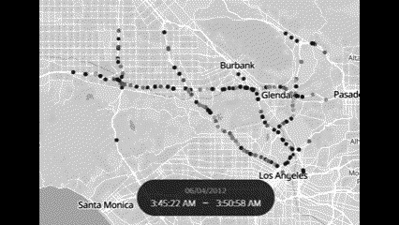
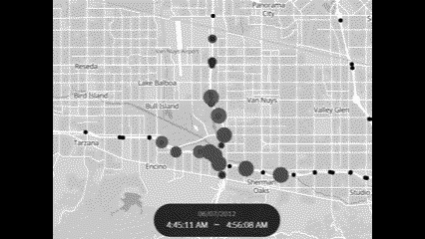
Framework
Explanation Phase
Cluster into
Input network
Global Search
Local Search
Important subgraph
Predicted event
Important subgraph events
Explains
Verbal Explanation Phase
Predicted event
Content Extraction
Verbal Translation
Extracted Content
Important subgraph events

Slide 11
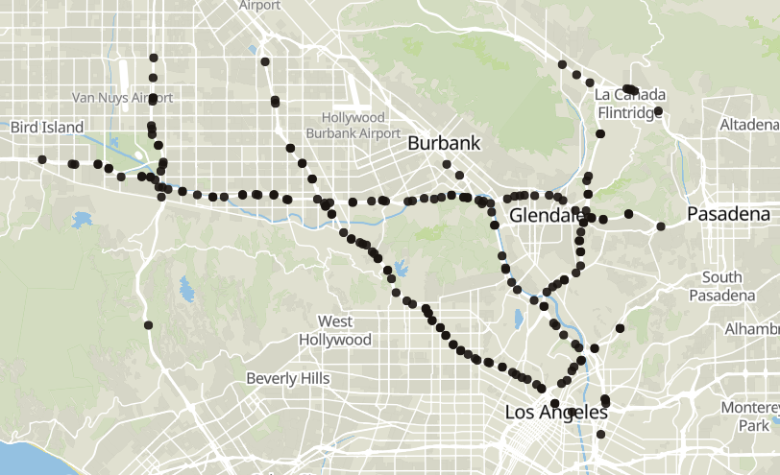
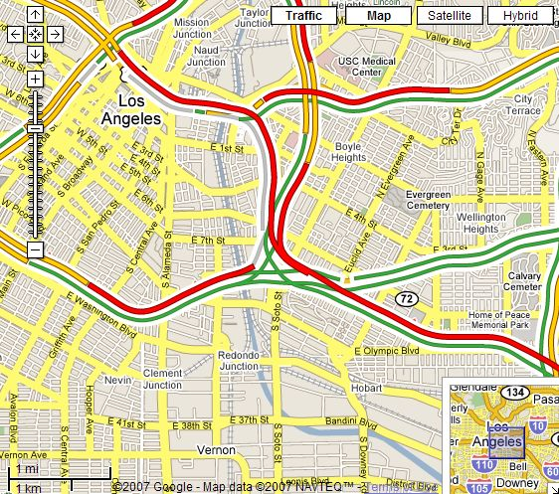
Explanation Phase - Global Search
Score input nodes importance to output nodes
Extract subgraph of input network by score
Localized Spatial Correlation¹
Flow Correlation²
input
input
output
output
t0
t1
t2
t3
Output node
Area of influence
Congested Section
Free Flowing Section
Output node
[1] Li et al., “Estimate the limit of predictability in short-term traffic forecasting: an entropy-based approach”, 2022. https://www.sciencedirect.com/science/article/pii/S0968090X22000535.
[2] Gerlough et al., “Traffic Flow Theory - A Monograph”, 1975, https://onlinepubs.trb.org/onlinepubs/sr/sr165/165.pdf

Slide 12
Explanation Phase - Local search
Refines input subgraph by global heuristic
Finds important subgraph
Instance specific
Monte Carlo Tree Search
Input subgraph by global search
Important subgraph
MCTS
Simulations from the root to a leaf
Root: input subgraph by global search
Leaf: candidate important subgraphs.
Important subgraph: leaf with largest reward.

Slide 13
Explanation Phase - Important Subgraph Events Extraction
Agglomerative Clustering
Cluster important subgraph into events of congestion or free flow
Events illustrate shaping of the predicted event
Important subgraph
Notes:
Cluster important subgraph into events of congestion or free flow
Events illustrate how previous traffic conditions contribute to shaping the predicted outcome

Slide 14
Verbal Explanation Phase
Content Extraction
Verbal Translation
Formulation:
First paragraph: predicted event
Other paragraphs: important subgraph events
From important subgraph events and event to explain
Template-based
Fill placeholders with extracted content
Speed
Label
Location
Date
Time
Notes:
Traffic Network: A graph structure defining the speed of the nodes of a geographical network during a certain time window.
STGNN: Black-box model that given an input traffic network can predict the behavior of the traffic network in the future.

Slide 15
03
Results

Slide 16
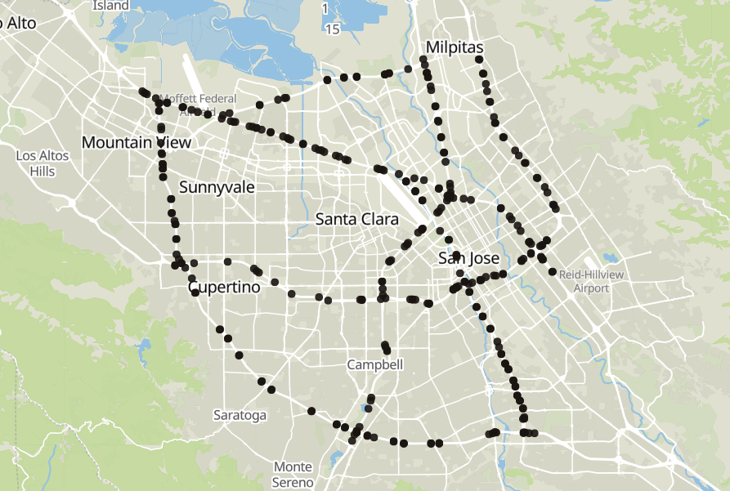
Data
METR-LA
PEMS-BAY
207 sensors
4 months
325 sensors
6 months

Slide 17
STGNN Results
 | Severe Congestion |  |  | Congestion |  |  | Free-Flow
 | MAE | RMSE | MAPE | MAE | RMSE | MAPE | MAE | RMSE | MAPE
METR-LA | 12.2 | 17.9 | 65.1% | 5.21 | 7.73 | 10.6% | 1.96 | 4.16 | 3.02%
PEMS-BAY | 10.6 | 15.8 | 49.1% | 4.46 | 7.05 | 9.23% | 1.07 | 1.95 | 1.64%
MAE
RMSE
MAPE
Mean Absolute Error
Root Mean Squared Error
Mean Absolute Percentage Error

Slide 18
STGNN Results
 | Severe Congestion |  |  | Congestion |  |  | Free-Flow
 | MAE | RMSE | MAPE | MAE | RMSE | MAPE | MAE | RMSE | MAPE
METR-LA | 12.2 | 17.9 | 65.1% | 5.21 | 7.73 | 10.6% | 1.96 | 4.16 | 3.02%
PEMS-BAY | 10.6 | 15.8 | 49.1% | 4.46 | 7.05 | 9.23% | 1.07 | 1.95 | 1.64%
MAE
RMSE
MAPE
Mean Absolute Error
Root Mean Squared Error
Mean Absolute Percentage Error

Slide 19
STGNN Results
 | Severe Congestion |  |  | Congestion |  |  | Free-Flow
 | MAE | RMSE | MAPE | MAE | RMSE | MAPE | MAE | RMSE | MAPE
METR-LA | 12.2 | 17.9 | 65.1% | 5.21 | 7.73 | 10.6% | 1.96 | 4.16 | 3.02%
PEMS-BAY | 10.6 | 15.8 | 49.1% | 4.46 | 7.05 | 9.23% | 1.07 | 1.95 | 1.64%
MAE
RMSE
MAPE
Mean Absolute Error
Root Mean Squared Error
Mean Absolute Percentage Error

Slide 20
STGNN Results
 | Severe Congestion |  |  | Congestion |  |  | Free-Flow
 | MAE | RMSE | MAPE | MAE | RMSE | MAPE | MAE | RMSE | MAPE
METR-LA | 12.2 | 17.9 | 65.1% | 5.21 | 7.73 | 10.6% | 1.96 | 4.16 | 3.02%
PEMS-BAY | 10.6 | 15.8 | 49.1% | 4.46 | 7.05 | 9.23% | 1.07 | 1.95 | 1.64%
MAE
RMSE
MAPE
Mean Absolute Error
Root Mean Squared Error
Mean Absolute Percentage Error

Slide 21
Explainer Results
Fidelity⁻
Fidelity⁺
Sufficiency of explanations
Error by predicting event just with important subgraph
The lower the better
Necessity of explanations
Error by predicting event just with complement of important subgraph
The higher the better
STGNN
STGNN
Important subgraph
Re-predicted event
Complement of Important subgraph
Re-predicted event

Slide 22
Explainer Results
 | Severe Congestion |  | Congestion |  | Free-Flow
 | Fidelity⁻ | Fidelity⁺ | Fidelity⁻ | Fidelity⁺ | Fidelity⁻ | Fidelity⁺
METR-LA | 0.14 | 0.86 | 0.03 | 0.2 | 0.02 | 0.05
PEMS-BAY | 0.59 | 0.73 | 0.05 | 0.19 | 0.03 | 0.63
Fidelity⁻
Fidelity⁺
Sufficiency of explanations
Error by predicting event just with important subgraph
The lower the better
Necessity of explanations
Error by predicting event just with complement of important subgraph
The higher the better

Slide 23
Explainer Results
 | Severe Congestion |  | Congestion |  | Free-Flow
 | Fidelity⁻ | Fidelity⁺ | Fidelity⁻ | Fidelity⁺ | Fidelity⁻ | Fidelity⁺
METR-LA | 0.14 | 0.86 | 0.03 | 0.2 | 0.02 | 0.05
PEMS-BAY | 0.59 | 0.73 | 0.05 | 0.19 | 0.03 | 0.63
Fidelity⁻
Fidelity⁺
Sufficiency of explanations
Error by predicting event just with important subgraph
The lower the better
Necessity of explanations
Error by predicting event just with complement of important subgraph
The higher the better

Slide 24
Explainer Results
 | Severe Congestion |  | Congestion |  | Free-Flow
 | Fidelity⁻ | Fidelity⁺ | Fidelity⁻ | Fidelity⁺ | Fidelity⁻ | Fidelity⁺
METR-LA | 0.14 | 0.86 | 0.03 | 0.2 | 0.02 | 0.05
PEMS-BAY | 0.59 | 0.73 | 0.05 | 0.19 | 0.03 | 0.63
Fidelity⁻
Fidelity⁺
Sufficiency of explanations
Error by predicting event just with important subgraph
The lower the better
Necessity of explanations
Error by predicting event just with complement of important subgraph
The higher the better

Slide 25
Explainer Results
 | Severe Congestion |  | Congestion |  | Free-Flow
 | Fidelity⁻ | Fidelity⁺ | Fidelity⁻ | Fidelity⁺ | Fidelity⁻ | Fidelity⁺
METR-LA | 0.14 | 0.86 | 0.03 | 0.2 | 0.02 | 0.05
PEMS-BAY | 0.59 | 0.73 | 0.05 | 0.19 | 0.03 | 0.63
Fidelity⁻
Fidelity⁺
Sufficiency of explanations
Error by predicting event just with important subgraph
The lower the better
Necessity of explanations
Error by predicting event just with complement of important subgraph
The higher the better

Slide 26
Explainer Results
 | Severe Congestion |  | Congestion |  | Free-Flow
 | Fidelity⁻ | Fidelity⁺ | Fidelity⁻ | Fidelity⁺ | Fidelity⁻ | Fidelity⁺
METR-LA | 0.14 | 0.86 | 0.03 | 0.2 | 0.02 | 0.05
PEMS-BAY | 0.59 | 0.73 | 0.05 | 0.19 | 0.03 | 0.63
Fidelity⁻
Fidelity⁺
Sufficiency of explanations
Error by predicting event just with important subgraph
The lower the better
Necessity of explanations
Error by predicting event just with complement of important subgraph
The higher the better

Slide 27
Explainer Results
 | Sparsity | Average Time
METR-LA | 0.985 | 8.88 s
PEMS-BAY | 0.985 | 11.6 s
Sparsity
Average Time
Conciseness of Explanations
The higher the better
Average computation time
The lower the better

Slide 28
Verbal Translation Example
“A severe congestion was anticipated on San Diego Freeway at kms 11, 12, 14 and 15 on Saturday, 07/06/2012, with an average speed of 21.05 km/h from 07:45 to 08:40. This occurred because of a series of congestions.”
San Diego Freeway
Ventura Freeway

Slide 29
Verbal Translation Example
“To commence, a contributing congestion manifested, with an average speed of 91.14 km/h, on Ventura Freeway at kms 25, 27, 28, 29, 30 and 31 occurring from 06:45 to 07:35. The congestion also happened on San Diego Freeway at kms 11, 12 and 13.”
San Diego Freeway
Ventura Freeway

Slide 30
Verbal Translation Example
“After that, a contributing severe congestion materialized, with an average speed of 21.77 km/h, on, once more, San Diego Freeway at kms 9, 10, 11, 12, 13, 14 and 15 occurring from 06:45 to 07:40. The severe congestion also happened on, another time, Ventura Freeway at km 27.”
San Diego Freeway
Ventura Freeway

Slide 31
Verbal Translation Example
“Ultimately, another contributing congestion happened on, once again, San Diego Freeway at km 10, with an average speed of 82.31 km/h, from 07:25 to 07:30.”
San Diego Freeway
Ventura Freeway

Slide 32
04
Conclusions

Slide 33
Conclusions
Explain speed prediction by STGNN
Transparent
Model agnostic
Verbal narratives
Effectiveness in explaining events aligned with STGNN power
Limitations
Difficulty for rare events
Domain specific
Future work
Extending to diverse domains
Assessing model agnosticity

Slide 34


Thanks
Do you have any questions?

Slide 35
Appendix

Slide 36
Prediction Phase - STGNN¹
Input [0, … T]
Output [T+1, … T’]
Given an input traffic network at times 0, … T obtain the predicted traffic network at successive times T+1, …, T’.
Spatial encoding through GCN.
Local temporal encoding through GRU.
Global temporal encoding with transformer.
STGNN
[1] Wang et al., “Traffic Flow Prediction via Spatial Temporal Graph Neural Network”, Association for Computing Machinery 2020, https://doi.org/10.1145/3366423.3380186

Slide 37
Prediction Phase - STGNN Details
0
1
T
…
Input [0, … T]
GCN
GCN
GCN
Output [T+1, … T’]
GRU
GCN
GRU
GRU
Transformer Layer

Slide 38
Prediction Phase - STGNN Training Details
Test set: last 80%
Train set: first 90% of remaining part
Validation set: last 10% of remaining part
200 epochs
Loss: Mean Absolute Error on non missing node speeds
Checkpoint on best validation
METR-LA
PEMS-BAY
Batch size: 64
Batch size: 32

Slide 39
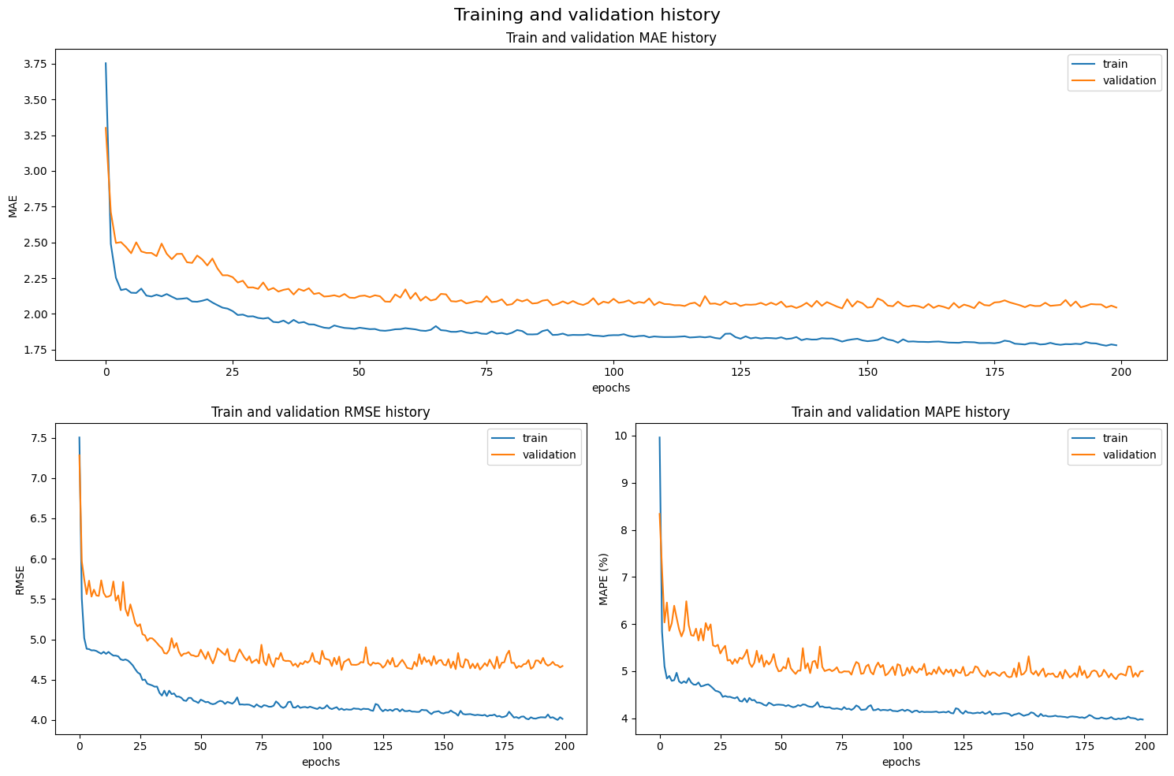
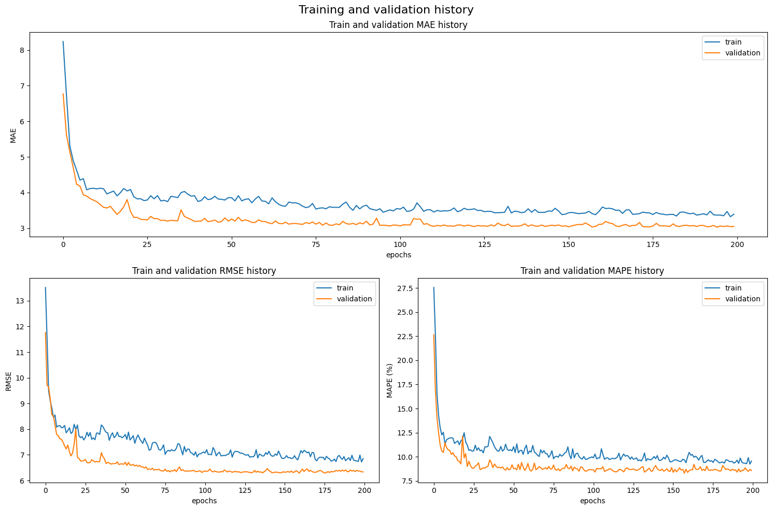
Prediction Phase - STGNN Training Details
METR-LA
PEMS-BAY

Slide 40
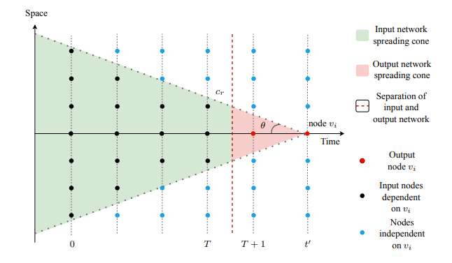

Explanation Phase - Global Search Details
Localized Spatial Correlation

Slide 41
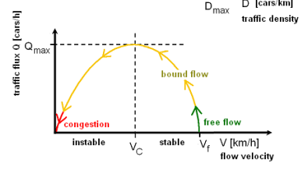
Explanation Phase - Global Search Details
Flow Correlation
Q = V D
Q: traffic flow V: speed D: traffic density

Slide 42
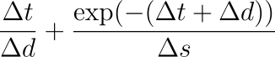
Explanation Phase - Global Search Details
Input node correlation with output node
Localized Spatial Correlation Score
Flow Correlation
Score
Averaged considering each output event node
𐤃t: time difference 𐤃d: spatial distance 𐤃s: speed difference

Slide 43

Explanation Phase - Monte Carlo Tree Search Details
Tree Root
Perform several rollouts (simulations) from the root to a leaf.
Root: input subgraph by global heuristic
Branching: remove traffic node from parent
Leaf: candidate important subgraphs.
Important subgraph: leaf with largest reward.
Input subgraph cut by Global Search
Objective
Tree Leaf
Tree Leaf
Reward: 0.9
Reward: 0.8
Important Subgraph

Slide 44
Explanation Phase - Monte Carlo Tree Search Details
Initialization
The tree root is set as the input nodes selected by the global heuristic.
Tree Root
Subgraph of Input Network by Global Heuristic

Slide 45
Explanation Phase - Monte Carlo Tree Search Details
Node Expansion
Parent Node
Randomly cut one traffic node from the parent node graph.
Set the graph with the removed node as a the graph contained in the child node.
Child Node
Removed traffic node

Slide 46

Explanation Phase - Monte Carlo Tree Search Details
Node Selection
Parent Node
Select node maximizing exploration and exploitation among the expanded ones.
Add it to the rollout path.
Repeat node expansion and selection until tree leaf is reached.
Selected
Child Node
Non-selected
Child Node
Rollout Path

Slide 47
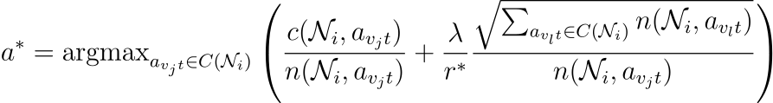
Explanation Phase - Monte Carlo Tree Search Details
Node Selection - Upper Confidence Bound for Trees (UCT)
Exploitation term
Exploration term
avjt: removing node vj at time t λ: Exploration Weight c(., .): cumulative reward
n(.,.) = cumulative visits C(.) = expanded branching actions r*: best reward

Slide 48
Explanation Phase - Monte Carlo Tree Search Details
Tree Leaf
Reward
Important Subgraph
Re-predictions
STGNN
Reciprocal MAE between original event to explain and the event re-predicted using just the leaf subgraph as input.
Leaves should meet sparsity threshold.
Removed nodes: missing speed flag in input graph (0 for METR-LA; -60 for PEMS-BAY)
Leaf reward (1/MAE)
Original predicted event
Re-predicted predicted event

Slide 49
Explanation Phase - Monte Carlo Tree Search Details
Update cumulative reward of a2 from N with leaf reward
Update cumulative reward of a1 from root with leaf reward
Backpropagation
Update statistics for node selection.
For each branching action from a node in the path:
Increase its visit count by 1.
Increase its cumulative reward by the leaf node reward.
a2
a1
Tree Leaf
Tree node N
Tree Root
Update visits of a2 from N by 1
Update visits of a1 from root by 1

Slide 50
Explanation Phase - Agglomerative Clustering Details
Dissimilarity metric¹
W: speed distance factor M_{s}: speed distance matrix
M_{d}: spatial distance matrix M_{t}: time distance matrix
[1] Lopez et al., “Revealing the day-to-day regularity of urban congestion patterns with 3D speed maps”, Sci Rep 7 2017, https://doi.org/10.1038/s41598-017-14237-8

Slide 51
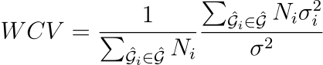
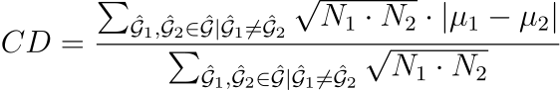
Explanation Phase - Agglomerative Clustering Details
Test number of clusters from 1 to 5 and get the one obtaining higher CD/WCV
Gi = ith cluster σ²_{i}: ith cluster speed variance
μ_{i}: ith cluster mean speed σ²: overall speed variance
N_{i}: ith cluster nodes

Slide 52
Explainer Parameters Details
Important Subgraph Size
Selected nodes by Global Heuristic
METR-LA: 2 × Event to explain size
PEMS-BAY: 3 × Event to explain size
2 × Important Subgraph Size
Rollouts
Exploration Weight
METR-LA: 30
PEMS-BAY: 50
METR-LA: 20
PEMS-BAY: 10

Slide 53
Verbal Explanation Phase - Content Extraction Details
Label^{1,2}
Speed ≤ 56 km/h
56 km/h < Speed ≤ 96 km/h
Speed > 96 km/h
Severe Congestion
Congestion
Free Flow
[1] Armanious, “District 07 mobility performance report: 2022 second
quarter”, 2022, https://dot.ca.gov/-/media/dot-media/programs/traffic-operations/documents/mpr/2022/q2/2022-d7-q2.pdf
[2] Gallego, ”District 05 mobility performance report: 2023 second quarter”, 2023, https://dot.ca.gov/-/media/dot-media/programs/traffic-operations/documents/mpr/2023/q2/2023-d5-q2.pdf

Slide 54
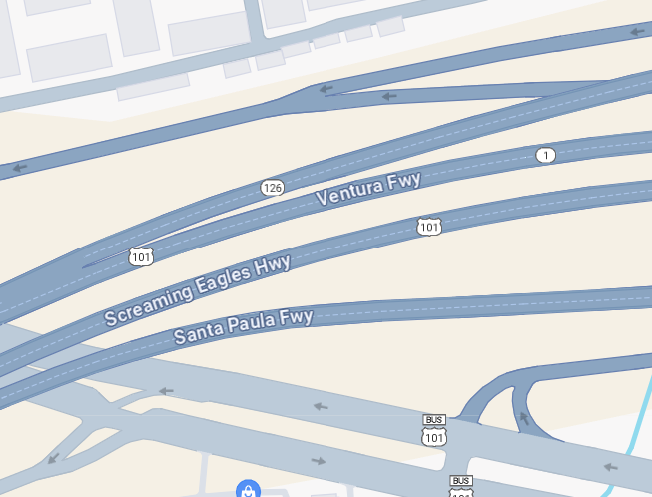
Verbal Explanation Phase - Content Extraction Details
Node involved in explanation
Location
Dictionary of streets
Streets with list of kilometrages of nodes involved
Kilometrage: spatial distance from start of street (north-westmost point)
Starting point Ventura Fwy

Slide 55
Verbal Explanation Phase - Content Extraction Details
Date
Weekday and date
Time
(start time, end time)

Slide 56
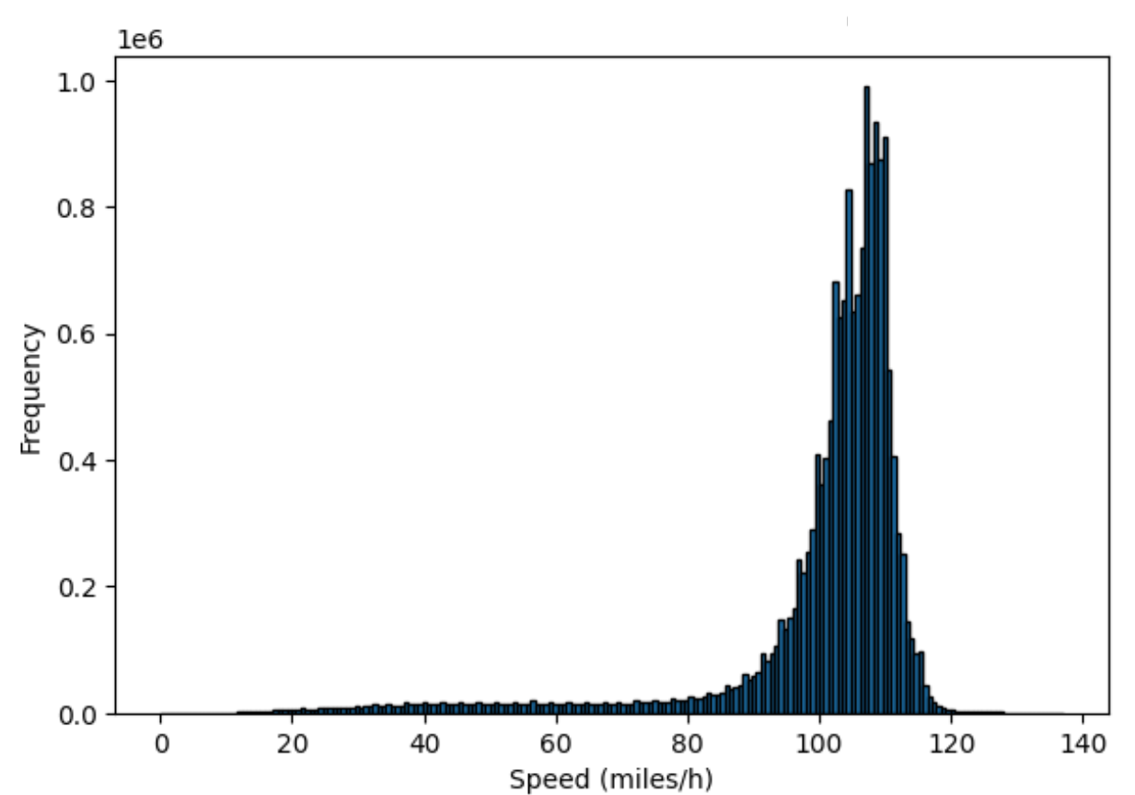
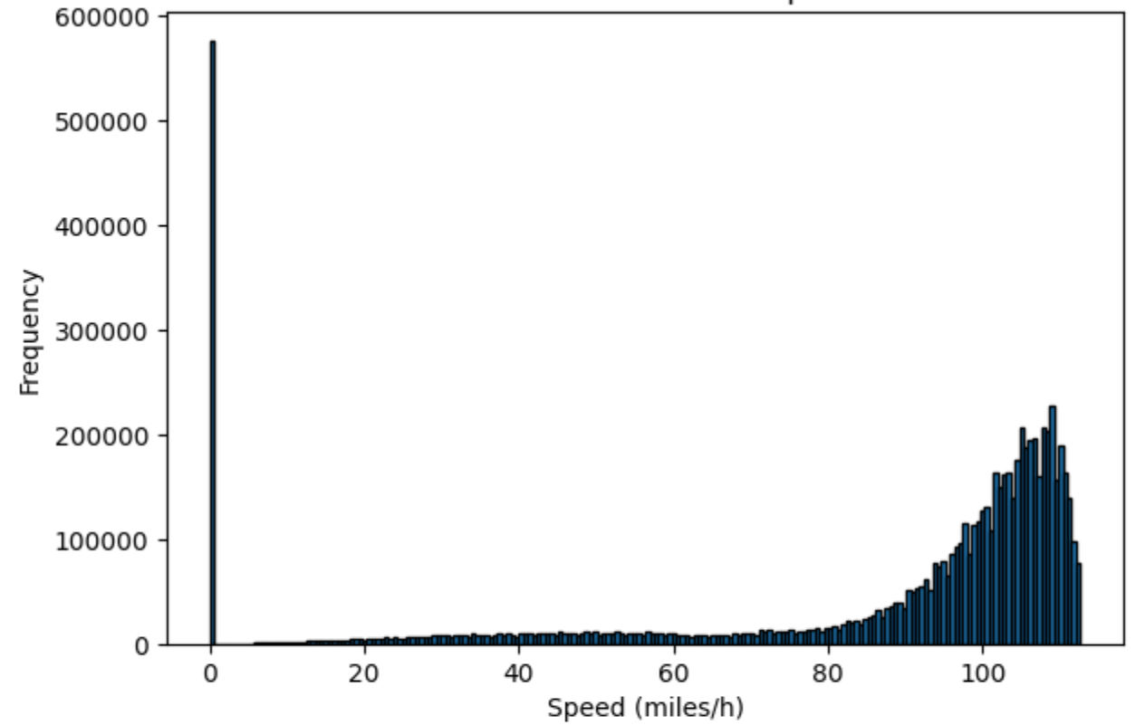
Data - Distribution
METR-LA
PEMS-BAY

Slide 57
Explainer Results - MAE
 | Severe Congestion |  | Congestion |  | Free-Flow
 | Fidelity⁻ | Fidelity⁺ | Fidelity⁻ | Fidelity⁺ | Fidelity⁻ | Fidelity⁺
METR-LA | 3.21 | 19.1 | 1.65 | 9.68 | 0.713 | 2.96
PEMS-BAY | 12.5 | 17.2 | 2.65 | 9.6 | 1.97 | 41.8
Fidelity⁻
Fidelity⁺
Sufficiency of explanations
Error by predicting event just with important subgraph
The lower the better
Necessity of explanations
Error by predicting event just with complement of important subgraph
The higher the better

Slide 58
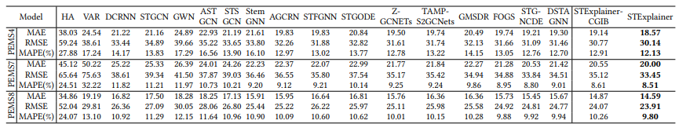
Fidelity⁻ Others

Slide 59
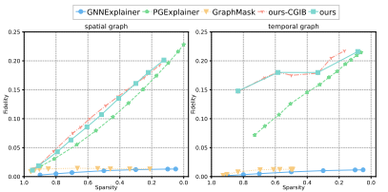
Fidelity⁺/Sparsity Others

